Slide 1
Agile Development
20th March 2021
4.00 – 5.00 pm
Dr.Sachin Bojewar
Vidyalankar Institute of Technology

Slide 2
What is Agile?

Slide 3
Agile Development Manifesto
Individuals and interactions over processes and tools
Working software over comprehensive documentation
Customer collaboration over contract negotiation
Responding to change over following a plan

Slide 4
Principles To Achieve Agility
1. Our highest priority is to satisfy the customer through early and continuous delivery of valuable software.
2. Welcome changing requirements, even late in development. Agile processes harness change for the customer’s competitive advantage.
3. Deliver working software frequently, from a couple of weeks to a couple of months, with a preference to the shorter timescale.
4. Business people and developers must work together daily throughout the project.
5. Build projects around motivated individuals. Give them the environment and support they need, and trust them to get the job done.
6. The most efficient and effective method of conveying information to and within a development team is face-to-face conversation.

Slide 5
7. Working software is the primary measure of progress.
8. Agile processes promote sustainable development. The sponsors, developers, and users should be able to maintain a constant pace indefinitely.
9. Continuous attention to technical excellence and good design enhances agility.
10. Simplicity—the art of maximizing the amount of work not done—is essential.
11. The best architectures, requirements, and designs emerge from self– organizing teams.
12. At regular intervals, the team reflects on how to become more effective, then tunes and adjusts its behavior accordingly.

Slide 6
Human Factors for Agility
Competence.
Common focus.
Collaboration.
Decision-making ability.
Fuzzy problem-solving ability.
Mutual trust and respect.
Self-organization.

Slide 7
Agile Process Models
XP (Extreme Programming)
ASD (Adaptive Software Development)
DSDM (Dynamic System Development Method)
Scrum
Crystal
FDD (Feature Driven Development)
AM (Agile Modeling)
Lean Software Development
AUP (Agile Unified Process)

Slide 8
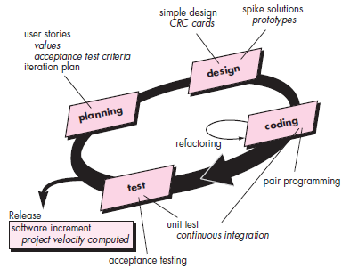
XP

Slide 9
ASD
Based on Collaboration and Team Self Organization
ASD Life Cycle
Speculation – Project Initiation, Adaptive Cycle Planning, Mission Statement, Project Constraint
Collaboration – Motivated People work together
Leaning – Focus group, FTR, Postmortems

Slide 10
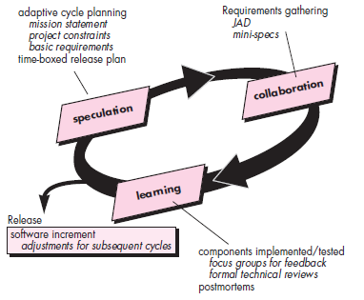
ASD

Slide 11
Dynamic System Development Method (DSDM)
Agile software development approach which provides framework to meet tight time constraint.
Uses incremental prototype in a controlled project environment.
Follows Pareto Principle.

Slide 12
DSDM Life Cycle
Feasibility Study
Establish basic business requirements and constraints and check for DSDM viability
Business Study
Establish functional and information requirements which will give business value.
Create basic architecture
Functional Model Iteration
Build functional prototype to produce deliverable
Design and build iteration
Modify prototype developed during functional model iteration to add value to business and user. (Functional and Design iteration can occur concurrently)
Implementation
Deploy latest prototype in user environment

Slide 13
Scrum
Scrum Development Activities
Backlog
List of important requirements which provides value to the user or business.
Sprints
Work units required to complete requirement specified in the backlog (30 days) Backlog cannot change during sprint.
Scrum Meeting
Conducted by Scrum Master
15 min daily held by scrum team. Addresses following questions
What is done since last meeting
Any obstacles
What is plan to accomplish by next meeting
Demos
Demonstrate implemented functionalities for customer feedback.

Slide 14
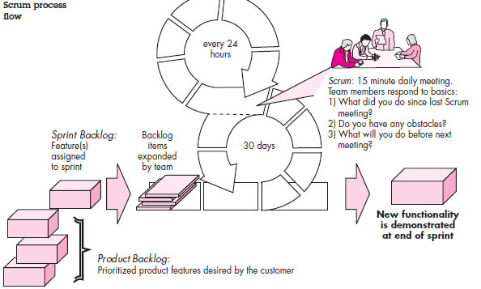

Slide 15
FDD
Process model for OOSE
What is Feature?
Client Valued function which can be implemented in 2 weeks or less.
FDD approach defines five collaborating framework activities
Overall Model
Feature List
Feature Plan
Feature Design
Feature Build

Slide 16
Agile Modeling - AM
“Agile Modeling is a collection of Values, Principles and practices for modeling that can be applied on a software development project in an effective and light weight manner.”
Agile model need not be perfect.

Slide 17
Agile Modeling Principles
Model with a purpose
Use multiple models
Travel light
Content is more important then representation
Know the model and tools you use
Adapt locally

